Slide 1


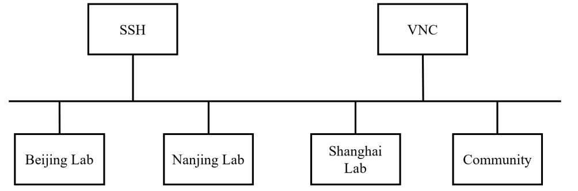
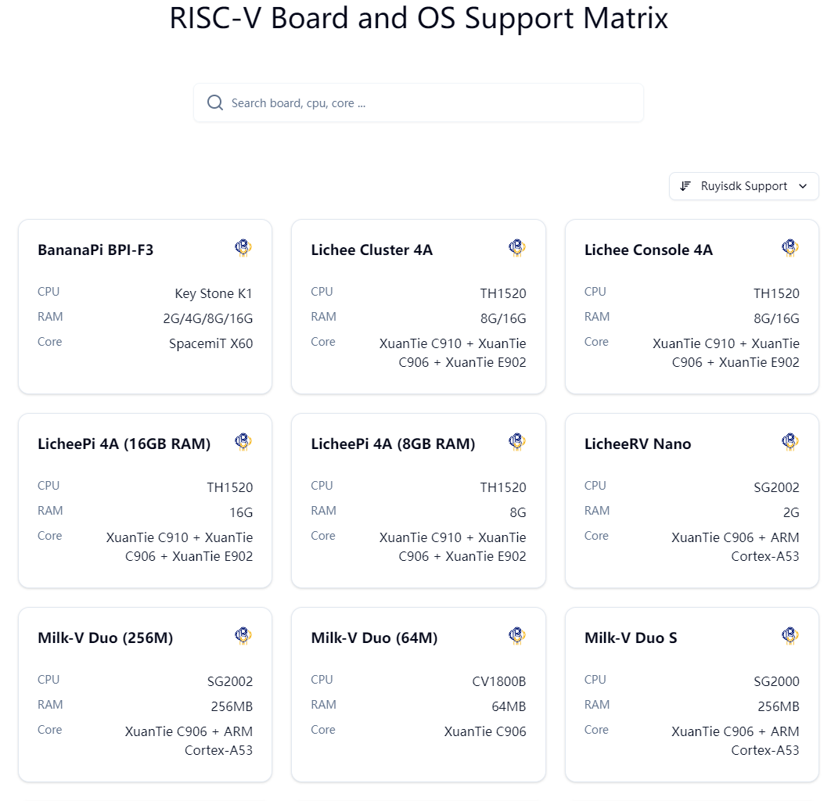
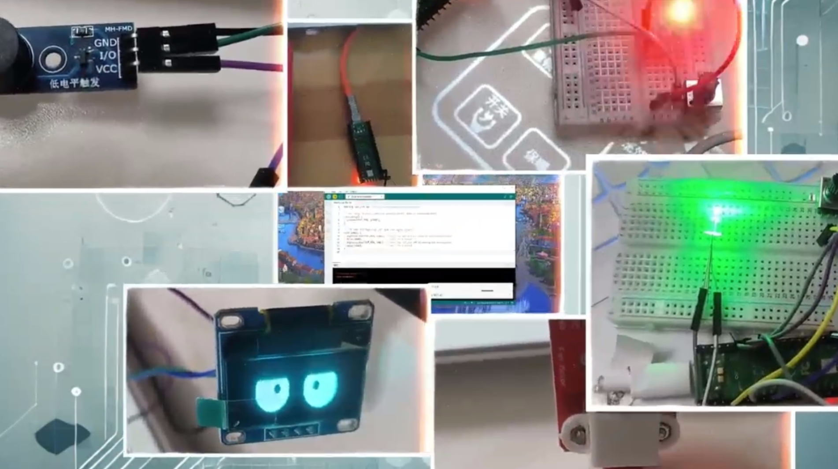
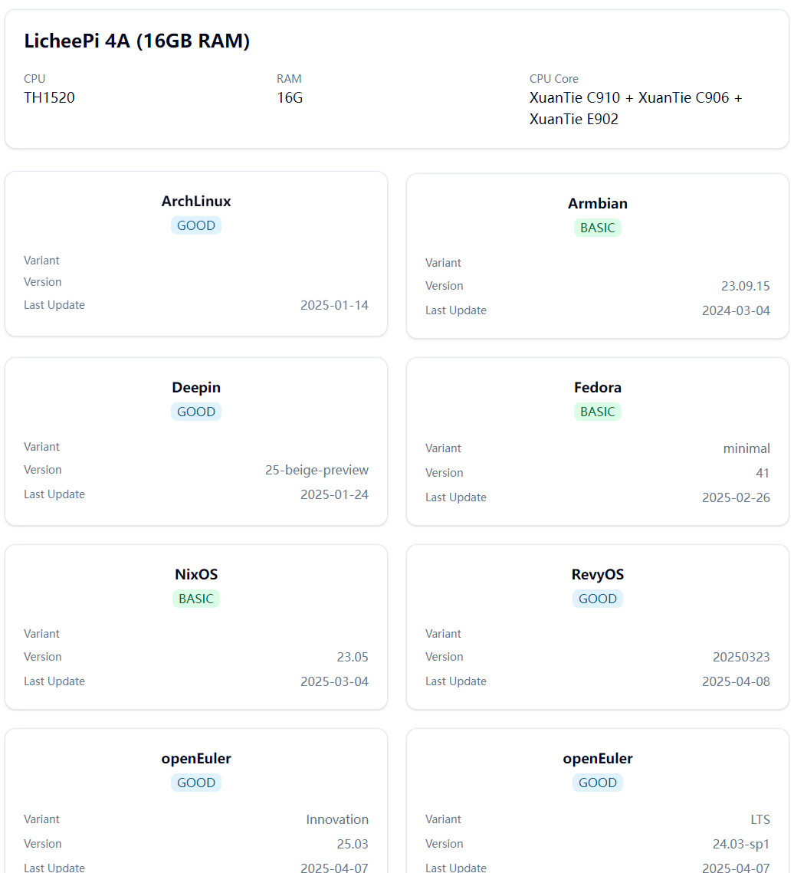
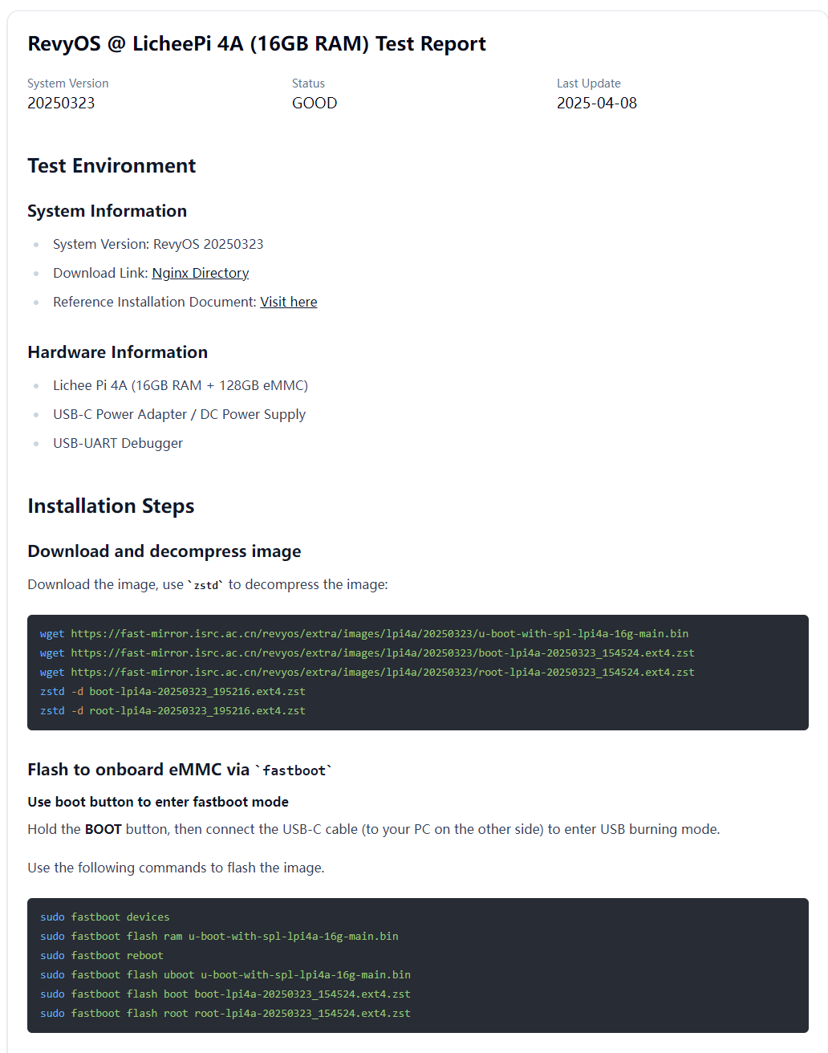
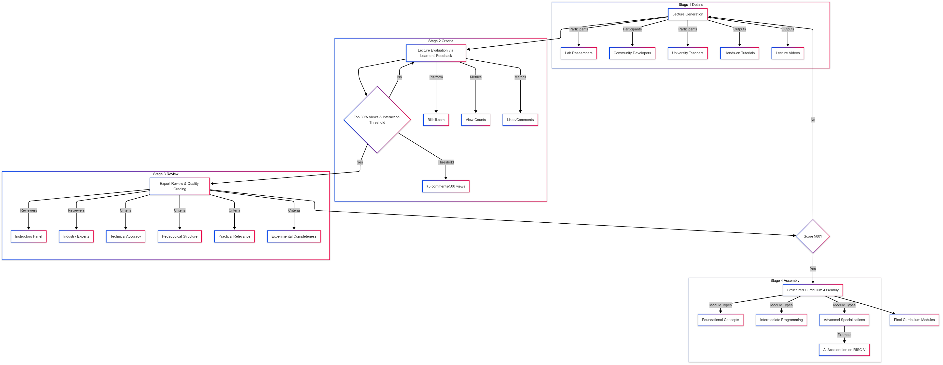



Building the RISC-V Education Ecosystem
—— A Systematic Educational Contents Design, Remote Laboratories, and Community-Driven Learning
Yunxiang Luo, Fuyuan Zhang, Tianwei Jiang, Zhi Li, Hang Zheng, Xirui Hao
Institute of Software, Chinese Academy of Science (ISCAS)
Email: {luoyunxiang, zhangfuyuan}@iscas.ac.cn
Motivation
While RISC-V has emerged as a promising open-source ISA, its educational ecosystem remains underdeveloped. Most course materials are fragmented, lacking clear progression from fundamentals to real-world applications. Hands-on experimentation is often out of reach for students due to the high cost and limited availability of development boards, especially outside major metropolitan regions. Moreover, the absence of an active, centralized learning community slows down knowledge exchange and learner retention.
Community Engagement
To An essential part of our ecosystem is the cultivation of a vibrant, learner-driven community. With over 30,000 participants on Bilibili and WeChat, we host weekly livestreams, interactive Q&A sessions, and technical discussions. Offline events include hardware hackathons and a RISC-V programming competition that bridges learners with industry mentors.
Results
To date, our Bilibili channels have published 859 educational videos, garnering over 1.33 million total views and nearly 39,000 likes. The main channel alone accounts for 748 videos, 1.29 million views, and 24,000 followers. Popular series include “RISC-V Software Porting and Optimization Championships,” “Hands-on RISC-V Simulator Tutorials,” and “Writing a RISC-V Compiler from Scratch.”
Metric | Primary Channel | Secondary Channel | Total
Number of Videos | 748 | 111 | 859
Total Views | 1.294 million | 41,000 | 1,294,410
Total Likes | 37,000 | 1,876 | 38,876
Total Followers | 24,000 | 462 | 24,462
Curriculum Framework
To address the challenges identified in RISC-V education and ecosystem development, we propose a three-pronged approach encompassing curriculum development, remote laboratory infrastructure, and community-driven engagement.
The curriculum design process follows a systematic four-stage workflow, referencing the figure above, ensuring quality control and adaptability to evolving technological trends. First of all is the lecture generation, weekly seminars are conducted with laboratory researchers, community developers, and university teachers to identify high-impact projects and translate them into lectures. These sessions produce hands-on tutorials, and lecture videos. The second step is lecture evaluation via learners’ feedback, all lectures are published on Bilibili.com, where learner engagement metrics (e.g., view counts, likes, comments) are monitored. Videos ranking in the top 30% of views and meeting predefined interaction thresholds (e.g., ≥5 comments per 500 views) proceed to formal review. The third step is expert review and lecture quality grading, a panel of instructors and industry experts evaluates shortlisted materials using a scoring rubric, referencing the table below. Criteria include technical accuracy, pedagogical structure, practical relevance, and experimental completeness. Courses scoring ≥80 are certified for integration into the formal curriculum. The last step is structured curriculum assembly, the approved courses are organized into tiered modules, spanning foundational concepts, intermediate programming topics, and advanced specializations (e.g., AI acceleration on RISC-V).
Remote Laboratory Infrastructure
To overcome the physical limitations of hardware availability, we built a distributed remote laboratory environment spanning Beijing, Nanjing, and Shanghai. The lab integrates RISC-V boards such as the HiFive Unmatched and Licheepi4A, enabling access via SSH and VNC protocols. It supports remote firmware flashing through SD Mux and offers power control through smart outlets. A compatibility matrix has been developed to ensure seamless operation across multiple Linux distributions and RTOS platforms.
Incubated Projects
Understand RISC-V https://space.bilibili.com/1829697/channel/collectiondetail?sid=3467927
Arduino on RISC-V Boards
https://space.bilibili.com/1829697/channel/collectiondetail?sid=3744568
WiringX on RISC-V Boards https://space.bilibili.com/1829697/channel/collectiondetail?sid=4258135
Floating Bridge for RISC-V Computing https://space.bilibili.com/1829697/channel/collectiondetail?sid=4096361
YOLO on RISC-V Boards
https://space.bilibili.com/1829697/channel/collectiondetail?sid=5119595
Conclusion
This initiative bridges the gap between RISC-V's technical potential and the practical need for scalable education. By combining structured curriculum pipelines, remote hardware access, and an active learner community, we offer a reproducible model for global RISC-V talent development. Our approach not only lowers the entry barrier for new learners but also accelerates innovation by enabling hands-on exploration of next-generation processor technologies.
Criteria | Description
Technical Accuracy | Alignment with RISC-V specifications
Pedagogical Structure | Logical progression and clarity of content
Practical Relevance | Real-world application and hands-on utility
Experimental Completeness | Inclusion of lab exercises and assessments
About Us
Bilibili
Channel 1
Bilibili
Channel 2
OS Matrix
Author: Yunxiang Luo,Fuyuan Zhang,Tianwei Jiang ,Zhi Li,Hang Zheng,Xirui Hao
Institute of Software, Chinese Academy of Science (ISCAS)

